Slide 1
Cialdini: Six Weapons of Influence
Methods to increase the probability of compliance
Six weapons of influence:
Authority
Social proof
Liking
Scarcity
Commitment and Consistency
Reciprocity

Slide 2
Authority
Formal or informal authority?
Mostly a matter of perception
Standalone technique but might also be a prerequisite

Slide 3
Authority in cyber security
Offense:
Social engineering (pretending to be someone important when asking for access)
Scams (pretending to be a bank, national agency etc.)
Defense:
Bring in the experts!
But who is considered an expert?
System updates on Windows/MacOS?

Slide 4
Social Proof: Normative Influence
Herd behaviour/Following the majority
“Edition X is the most popular among customers”
“80% of people who stayed in this hotel room reused their towels.”

Slide 5
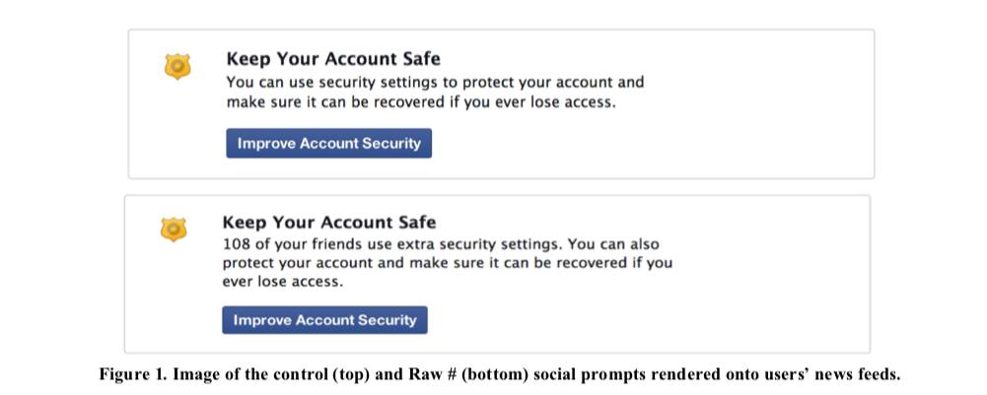
Social Proof in cyber security
Facebook study with 50,000 participants
Different security messages:
Measurement: Do people explore security options more when presented with a social proof message?
Answer: Yes, 37% more explorers.
Das, S., Kramer, A. D. I., Dabbish, L. A., & Hong, J. I. (2014). Increasing security sensitivity with social proof: A large-scale experimental confirmation.
Proceedings of the ACM Conference on Computer and Communications Security, 739–749. https://doi.org/10.1145/2660267.2660271

Slide 6
Liking
The more we like someone the more ‘likely’ we are to act.
Ways of influencing through liking:
Be friendly ☺
Similarity
Mimicry (physical/emotional)
Notes:
Similarity: Study with confederate who needed paper proofread.

Slide 7
Liking in cyber security
Offense:
Social engineering and scams (pretending to be similar to someone, activating empathy)
Defense:
Share stories from people who are similar to you (e.g. coworkers, fellow students)
Able to identify yourself with others

Slide 8
Scarcity
Restricting access increases wanting
Fear Of Missing Out (FOMO)
Time limits
Stock limits

Slide 9
Scarcity in cyber security
Offense:
Social engineering and scams: Adding time pressure to requests (e.g.: you need to act now to ensure your bank account won’t be blocked).
Defense:
Limit free resources at first (number of employees who can receive a free cybersecurity solution) to increase attention and want.

Slide 10
Commitment and consistency
People dislike being inconsistent
Once people commit, they are more likely to act.
Public commitment
E.g. signing up to things (Smoking posters)
Foot in the door technique
Billboards (Freedman & Fraser, 1966)
Turfmarkt
Freedman, J. I., & Fraser, S. C. (1966). Compliance Without Pressure.
Journal of Personality and Social Psychology, 4(2), 195–202. https://doi.org/10.1037/h0025009
Notes:
Billboards: 20% in control. 55% in experimental conditions (small 3” sticker road safety first, then huge billboard later)

Slide 11
Commitment and consistency in cyber security
Offense:
Romance scams where people are lured into making a small payment, and are asked for larger consecutive payments, reaching the tens of thousands Euros in damages before the scam is over.
Defense:
Don’t expect people to do everything at once.
Let them (publicly) commit to cyber security.
Make it easy to be consistent. (Streamline processes)
Sign up to something, then commit to broader policy.

Slide 12
Reciprocity
Tit for tat
We reciprocate favours, gifts, other niceties
Waiters in restaurants
Receiving chocolate increases tipping behavior
“That’s not all” Technique
Additional effort is reciprocated in increased likelihood of sale
Strohmetz, D. B., Rind, B., Fisher, R., & Lynn, M. (2002). Sweetening the till: The use of candy
to increase restaurant tipping. Journal of Applied Social Psychology, 32(2), 300-309.
Notes:
15.06% of the bill versus 17.84%

Slide 13
Reciprocity in cyber security
Offense:
Social engineers who do something for their target before making their request. E.g., opening a door for them, then hoping the target will open the door that has a swipe access lock.
Defense:
What can you give people in return for good cyber behaviour?
Message framing when IT services need people to update/install/change settings.
Better services
Other rewards?

